Slide 1
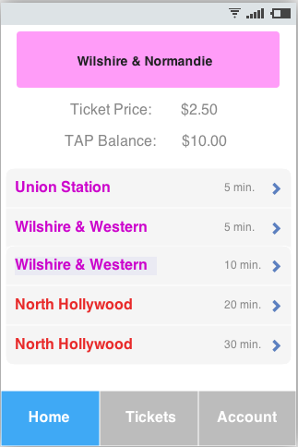
Rapid access pass
A Paradigm Shift in Public Transportation

Slide 2
Our Team
Prototype
Member | Role
Andrew Borba | Prototyper
Lizz Brooks | Project Manager
Jorge Go | Feasibility Analyst
Katherine Hu | Lifecycle Planner
Nakul Joshi | Software Architect
Ian Malave | Requirements Engineer
Rishi Mukhopadyay | Operational Concept Engineer
Overview
Requirements
Risks
Prototype

Slide 3
Agenda
Prototype
Project Overview
Project Requirements
Risk Analysis
Prototype of Features
Overview
Requirements
Risks
Prototype

Slide 4
Project Summary
Prototype
Create a mobile application for the LA metro which would allow riders to view schedules, purchase tickets, add funds to account, and use their device to board the metro train.
Overview
Requirements
Risks
Prototype

Slide 5
Project Overview
Key Partners:
LA Metro
Key Activities:
Software Design and Development
Integration with Metro Infrastructure
Marketing of Application
Key Resources:
Development Team
PhoneGap API
NFC Technology
QR Technology
Overview
Requirements
Risks
Prototype

Slide 6
Project Goals
Customer Convenience- Increase ways to purchase tickets and interact with the LA Metro
Technological Advancement- Enhance current TAP card system by incorporating the use of mobile devices
Reduce Resource Consumption- Save time and resources while creating a more user friendly interface with expanded payment options
Overview
Requirements
Risks
Prototype

Slide 7
Capability Requirements
Overview
Requirements
Risks
Prototype

Slide 8
Platform
The application shall be compatible with the iOS and Android mobile platforms.
The application shall support a web interface for mobile devices on other platforms.
Overview
Requirements
Risks
Prototype

Slide 9
User Accounts
If it is a users first-time opening the application, the application shall prompt the user to enter an email address, password, and credit card information.
If the account is created successfully, the application shall send a confirmation to the users stored email address.
If the account creation is not successful, the application shall display an error message that prompts the user to reenter their information and will not be logged in.
If a returning user opens the application, it shall prompt the user to enter their log-in information.
If the log-in attempt fails, the application will display an error message that prompts the user to reenter their log-in information.
If the log-in attempt succeeds, the user will be shown a transit management screen.
Overview
Requirements
Risks
Prototype

Slide 10
Usage
If the application loses connectivity, the application shall display an error message.
The application shall retrieve the users location at intervals of 120 ± 10 seconds.
If the user is within 150 feet of a train-stops geo-location coordinates, the train-stops name, ticket price, and incoming train information shall be displayed on the user interface.
If train stop information is being displayed on the applications user interface, the application shall update the train stops incoming train information at intervals of 30 ± 5 seconds.
Overview
Requirements
Risks
Prototype

Slide 11
Level of Service Requirements
Overview
Requirements
Risks
Prototype

Slide 12
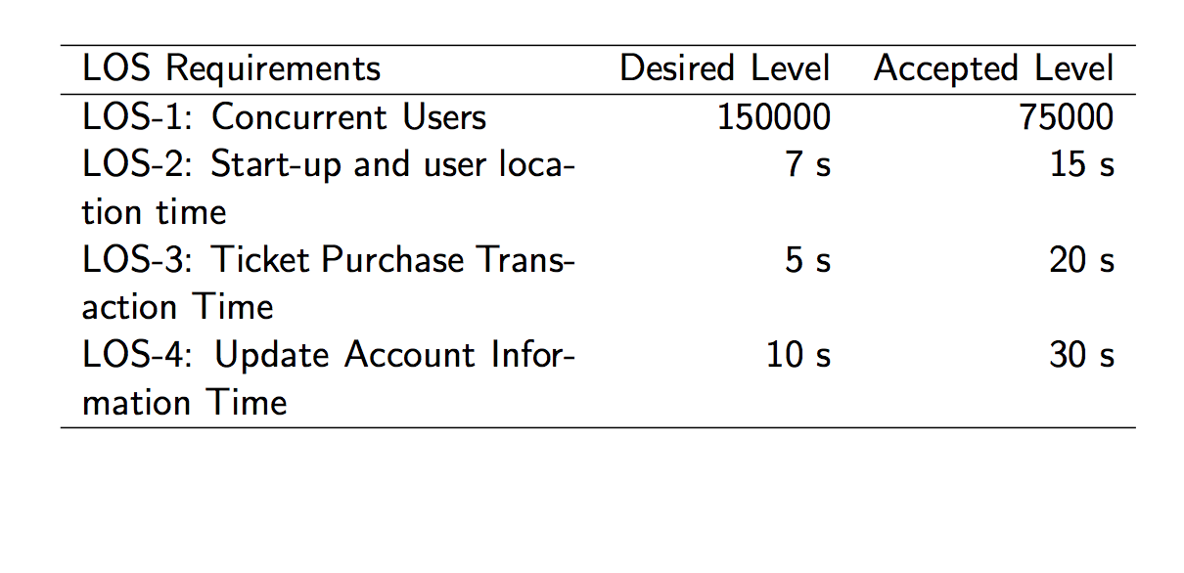
Overview
Requirements
Risks
Prototype

Slide 13
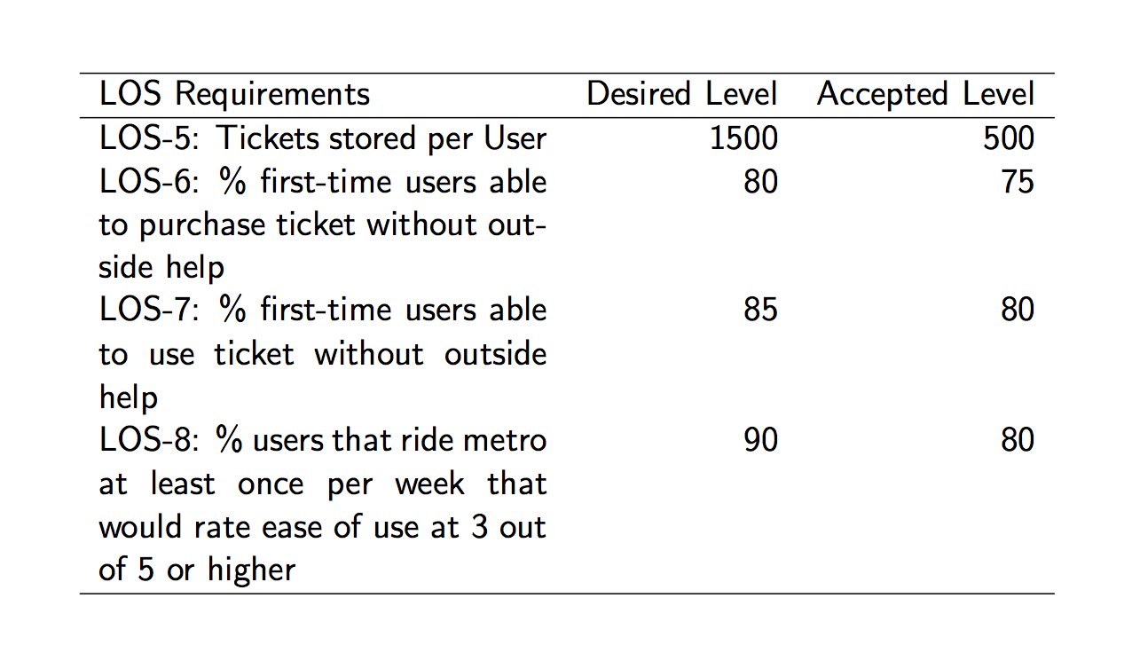
Overview
Requirements
Risks
Prototype

Slide 14
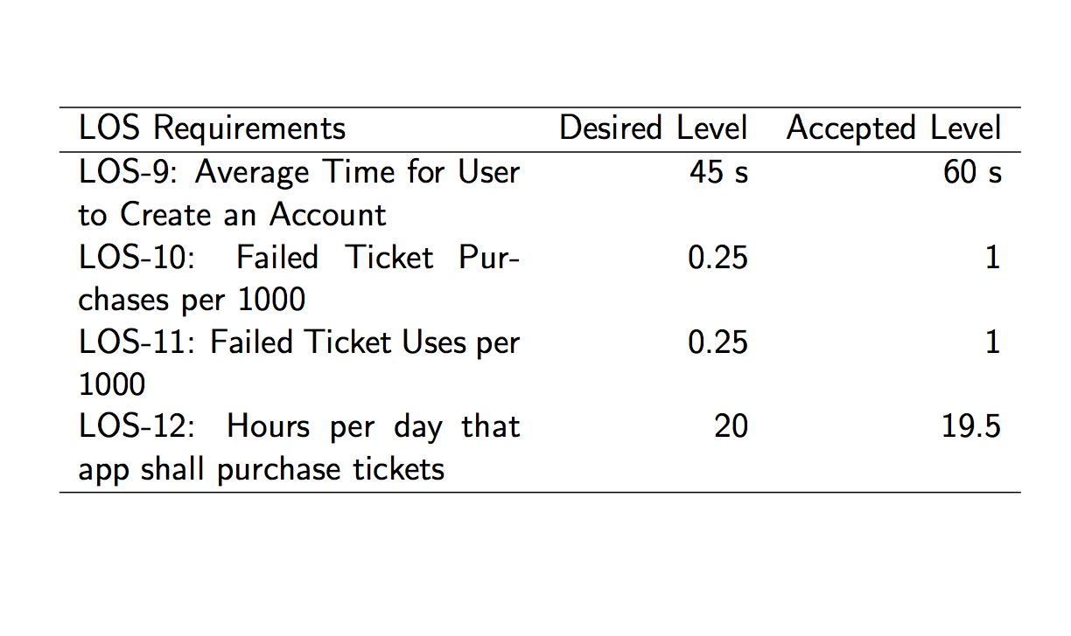
Overview
Requirements
Risks
Prototype

Slide 15
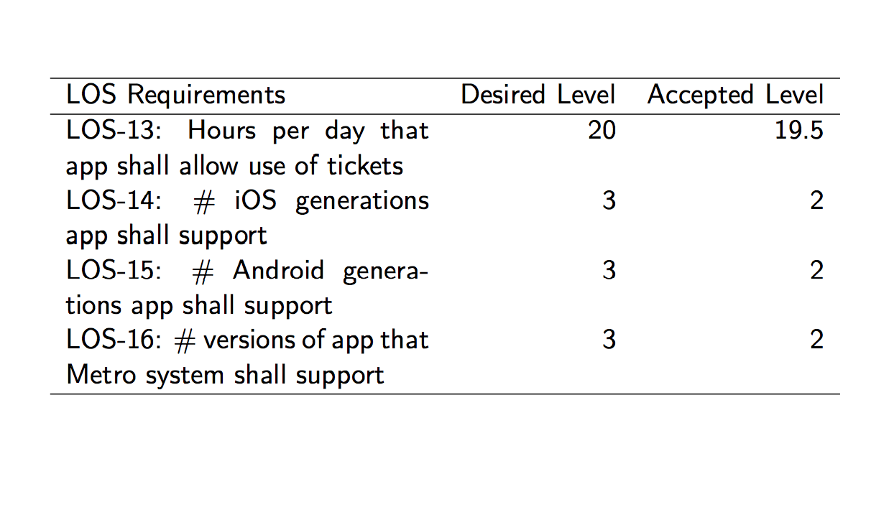
Overview
Requirements
Risks
Prototype

Slide 16
Risks
Overview
Requirements
Risks
Prototype

Slide 17
Project Risks
 | Risk Description | Risk Mitigation Actions
Security | Unsecured platform might be easily exploited or manipulated, costing the client lost revenue | Data encryption
Partnership | LA Metro might not be willing to implement our system, or allow us to test compatibility with their system | Proof of Concept and further talks with Metro authorities
Technology | Possibility of technical malfunctions might cause boarding delays and other inefficiencies | Back-up system and expectations management
Estimation | The estimated mount of work might not be completed in two semesters, or another developer might implement the system first. | Time management and updated timelines
Requirements | Requirements may change after the platform has been implemented | Updates and Documentation
People | Team members might lack necessary expertise in certain development requirements | Identify team strengths and weaknesses
Compatibility | Cross-platform consistency issues may arise if different devices have different browser characteristics | Run beta tests on multiple popular platforms (iPhone, Android)
Organizational | Team roles might not fit specific project requirements | Dynamically change team member roles
Overview
Requirements
Risks
Prototype

Slide 18
Prototype
Overview
Requirements
Risks
Prototype

Slide 19
Account Creation Process
Overview
Requirements
Risks
Prototype

Slide 20
Rationale for Prototype
Basis of rapid access authentication system
Electronic tickets and credits are stored via account identifiers
User account malfunction will cause the rest of the system to malfunction.
Essential to integration with the current tap card system.
Authentication security is essential for protection of personal information.
Credit Card Payment and Authentication
Overview
Requirements
Risks
Prototype

Slide 21
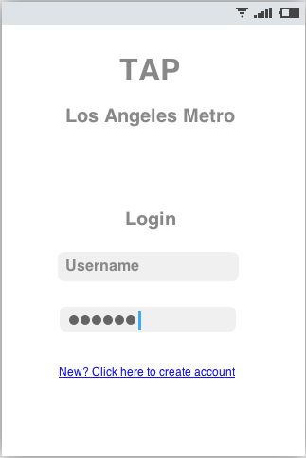
Login
Overview
Requirements
Risks
Prototype

Slide 22
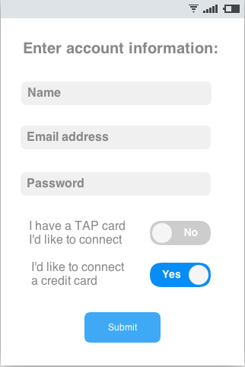
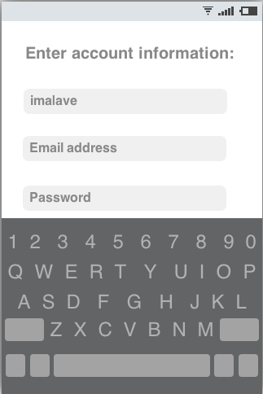
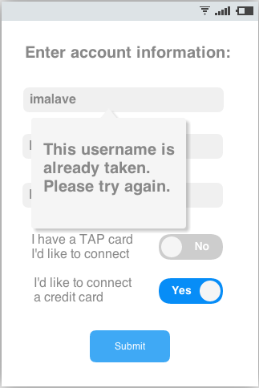
Create an Account
Overview
Requirements
Risks
Prototype

Slide 23
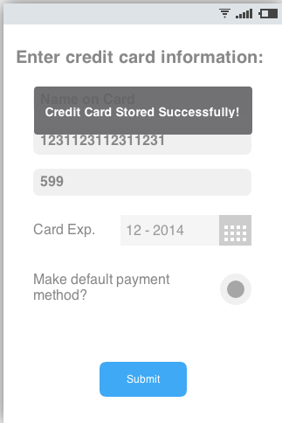
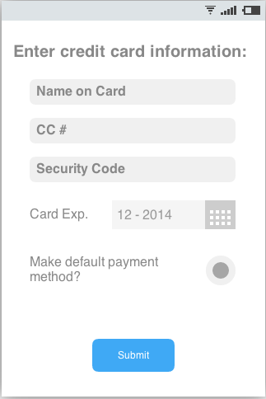
Store Credit Card Information
Overview
Requirements
Risks
Prototype

Slide 24
View Balance & Tickets
Overview
Requirements
Risks
Prototype

Slide 25
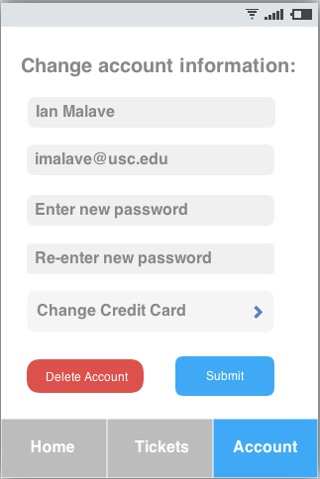
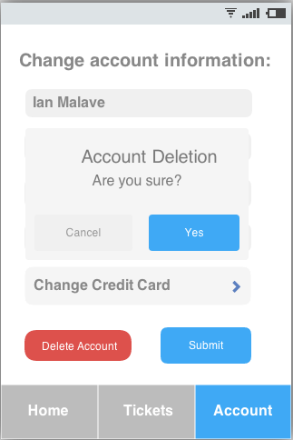
Edit/Delete Account
Overview
Requirements
Risks
Prototype

Slide 26
Log Out
Overview
Requirements
Risks
Prototype

Slide 27
QR Code Generation
Overview
Requirements
Risks
Prototype

Slide 28
Risk Based Rationale
Fundamental method of communication between smartphone and metro officials/turnstiles.
Failure of QR code generation will cause the rest of the system to become non functional.
Security risks
Risk of duplication and production of counterfeit tickets.
Potential for compromise of personal information through “hacked” QR codes.
Overview
Requirements
Risks
Prototype

Slide 29
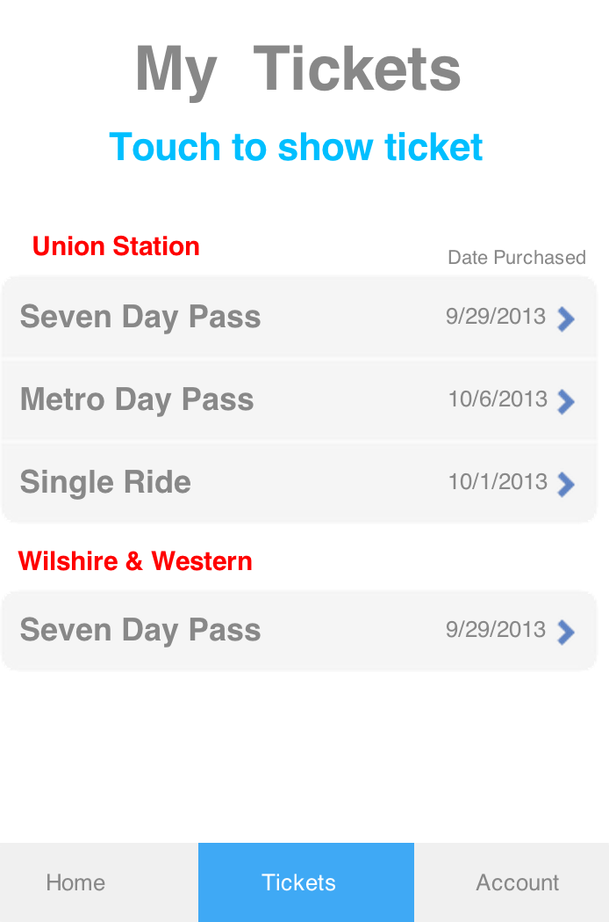
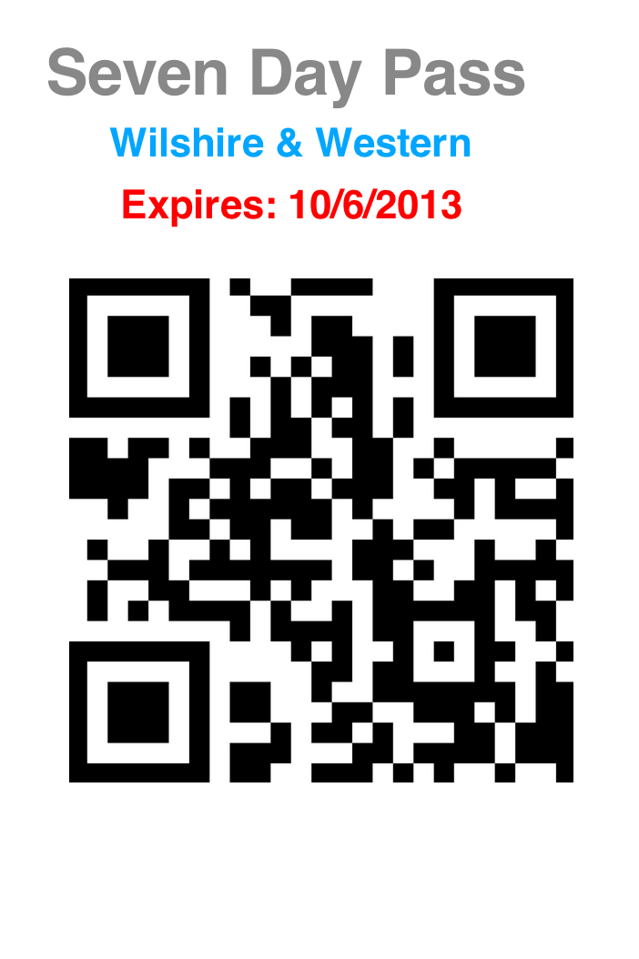
QR Code Prototype
Overview
Requirements
Risks
Prototype

Slide 30
Thank You! We will take questions at this time.
Overview
Requirements
Risks
Prototype

